Slide 1
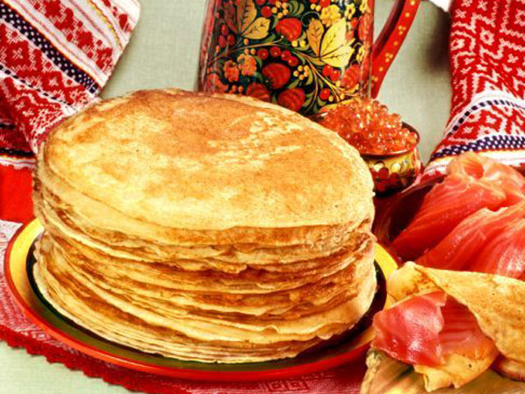
Pancake Day in Ukraine

Slide 2
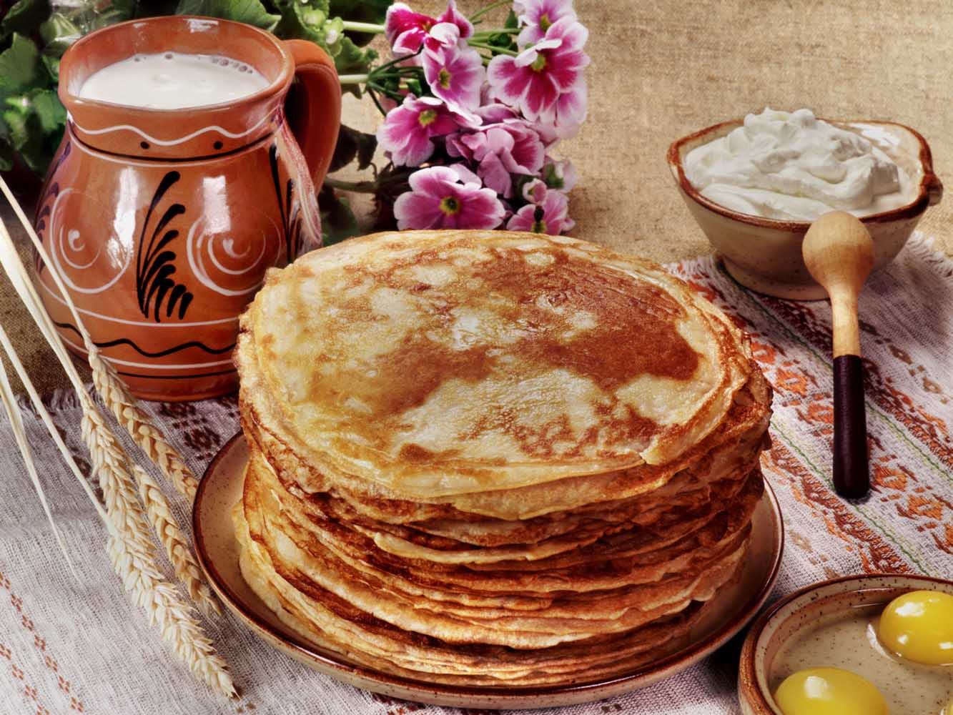
The last week before the Great Fast coincided with pagan holiday of seeing off the winter and meeting of the spring, which was celebrated by all people of Europe in the pre-Christian period. The east Slavs called this holiday “Maslenitsa”.

Slide 3
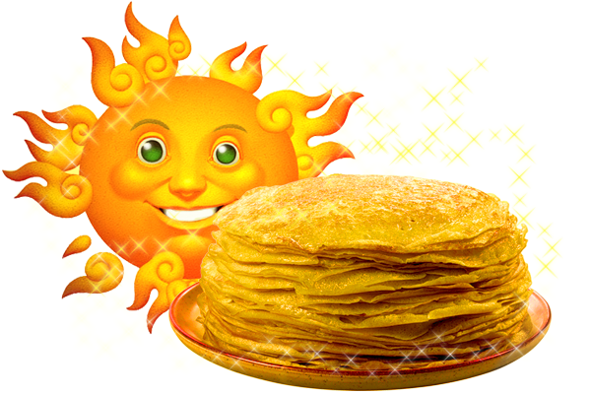
The rituals of Pancake Day, saved in the folk tradition up to our times, are associated with the pagan cults of ancestors, family relations and fecundity. The necessary dish of this Day is the pancakes – pagan symbol of the sun. It was considered, that the last week before the Great Fast should be brought in a funny way, because ahead there were 7 weeks of the strict behaviour and different limits. Every day of this week has some definite peculiarities and interesting customs.

Slide 4
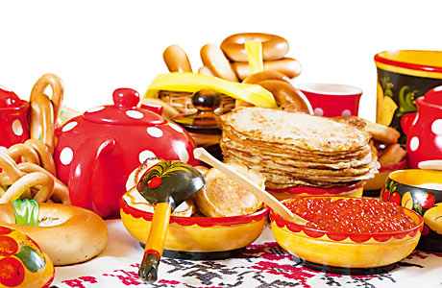
Monday - Meeting
Pancake week considered this Women's Day. Celebrated its fun and perky. The celebration starts on Monday. Pancakes were baked by men. These were the various pancakes, stuffed or not, as well as prepared dumplings and all that is round.

Slide 5
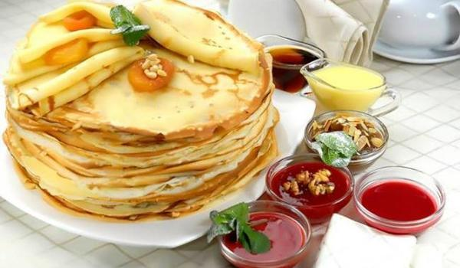
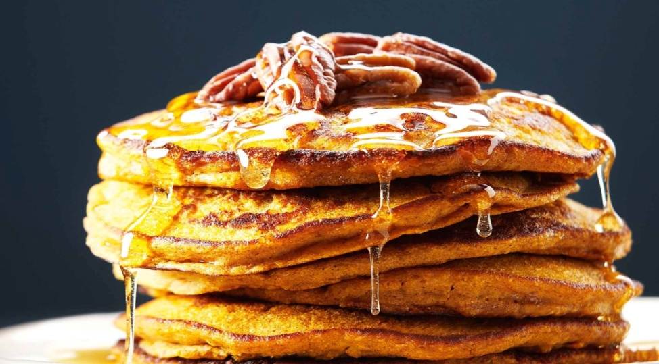
Tuesday - Zaigryshi
The people called this day zaigryshi: young, active people went out for a walk, began to visit each other's homes. Girls were invited to ride on a sleigh down a frozen hill.

Slide 6
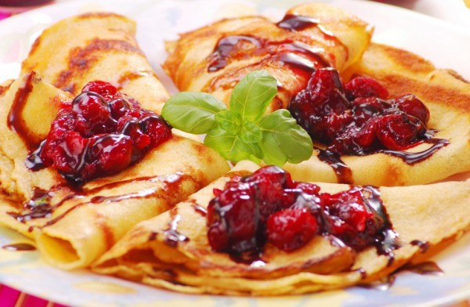
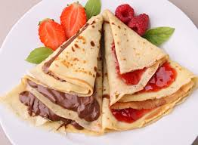
Also on this day there were bride brides, as all Pancake rituals, in fact, reduced to matchmaking, so that after Lent to celebrate a wedding. As families prepare cakes and dumplings with cottage cheese, fritters. Married women gathered again and had fun.

Slide 7
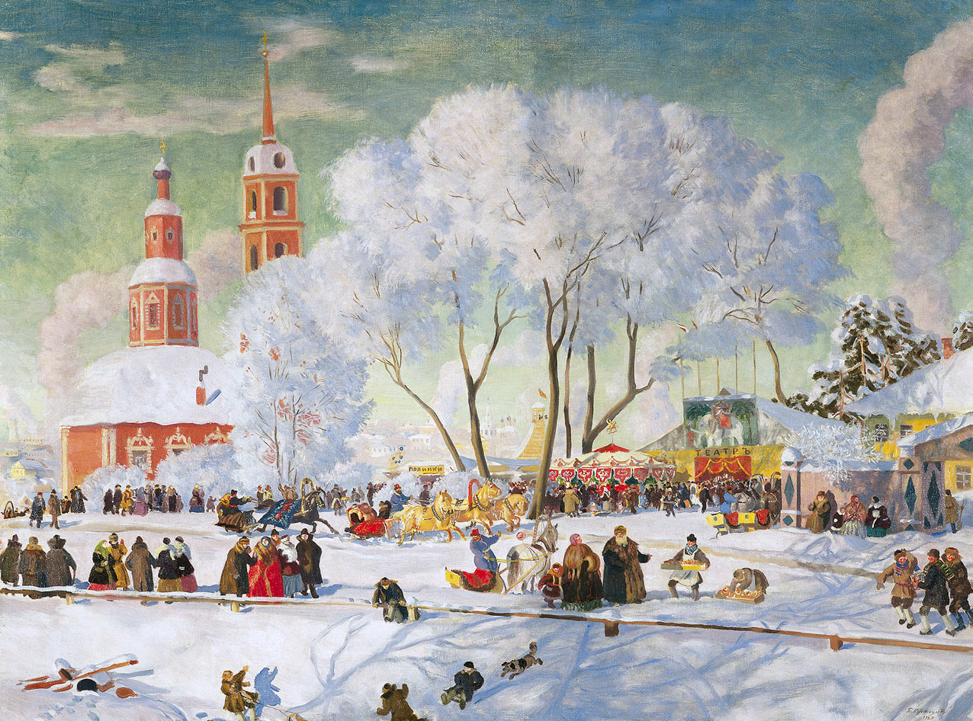
By the way the man went down, people judged the fate. For example, if moving out from the hill safely, then next year will be good. The further you will pass - the longer your life line is.

Slide 8
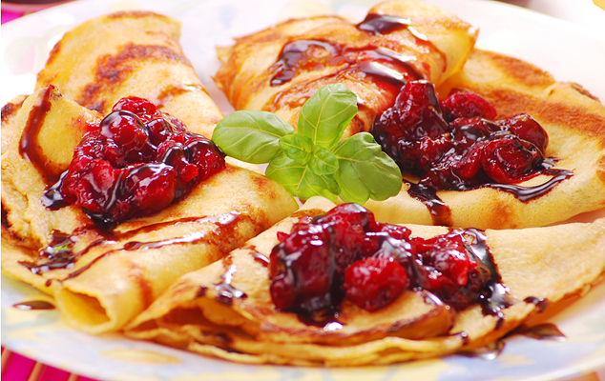
Wednesday - Gourmet
It was believed that on Pancake Day you need to eat as many pancakes as you wish.On that day sons-in-law must have to visit them. Usually for refreshments prepared and pancakes, dumplings, and with different fillings. The people believed that if a man chooses pancakes or dumplings with salty stuffing, so he is stubborn and with ambition. If sweet tasty, he will treat his wife gently and kindly.

Slide 9
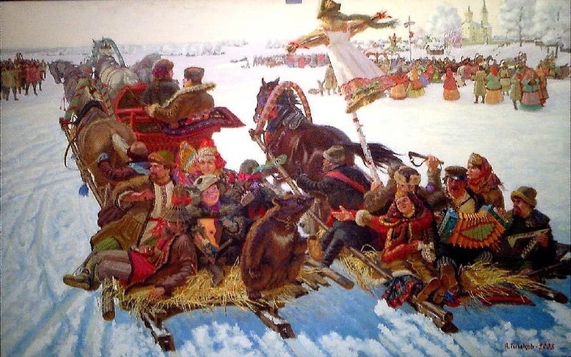
Wide Thursday
From Thursday began Broad Pancake week, stopped work on the farm, and the celebration unfolded to its full width. The people indulged in all sorts of fun, arranged horse riding, fights, various competitions, which were accompanied by eating pancakes and all sorts of dishes.

Slide 10
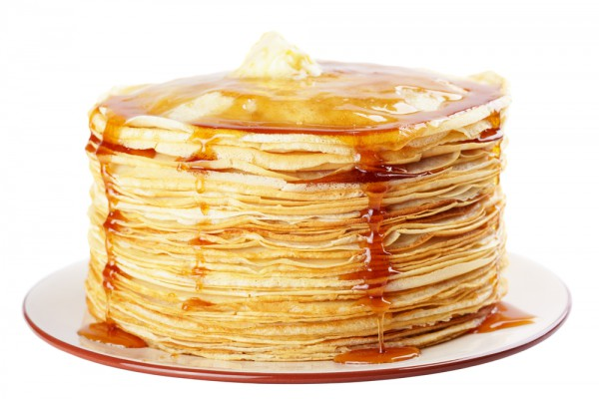
Friday - Teschin Vecherki
On Thursday evening, the son-in-law should be invited, friends and young relatives on pancakes. The greater number of people to invite the wife's mother, the better it symbolizes the respect of his son and his love for his wife.

Slide 11
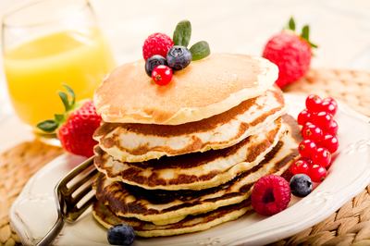
Saturday - Zolovkina gatherings
Pancake week is - a festival to strengthen family. Therefore remembered and still another relativе - her husband's sister. And on Saturday night was the burning of effigies of winter. Our ancestors believed this Pancake fire almost magical.

Slide 12
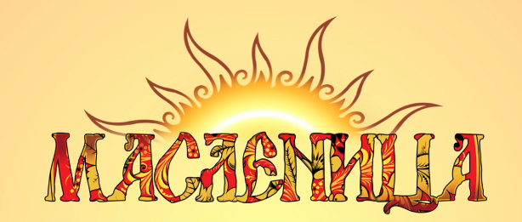
For example, burning the winter, a fire erupted any old thing, and with them all the troubles of the year. According to legends, the fire of its magical powers could purify of sorrows and negativity. After the ashes from the fire dispels on the field - it promised a good crop

Slide 13
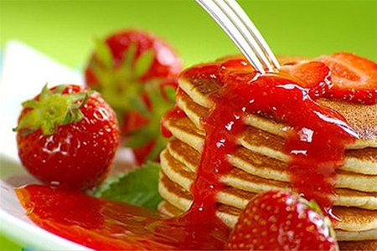
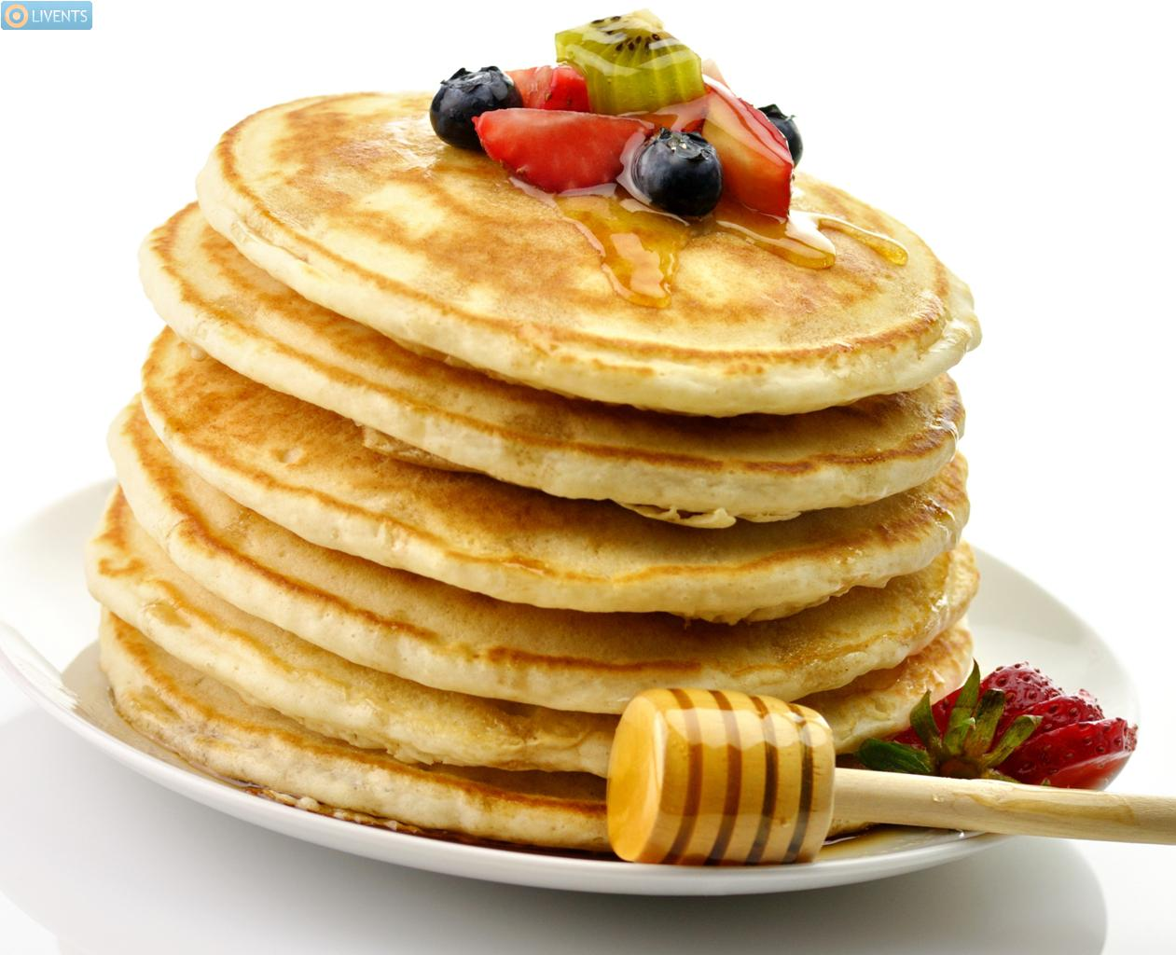
Sunday - Farewell Pancake
This day was supposed to get around all the relatives and friends, and ask for their forgiveness for intentional or unintentional offense, to the next day to begin Great Lent with the world in mind.

Slide 14
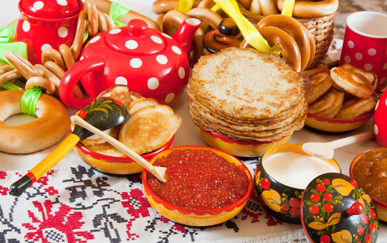
Thanks for watching

